Slide 1
Tkinter-Based Calculator Application
By:
Nakul Das

Slide 2
Project Overview
This project involves the development of a basic calculator application using Python's Tkinter library. The application will perform arithmetic operations such as addition, subtraction, multiplication, and division. It will include a user interface with buttons for digits, operators, and additional functionalities like clear and backspace.

Slide 3
Objective
The primary objective is to create a functional and user-friendly calculator that can handle basic arithmetic calculations. The application will be built with a graphical user interface (GUI) to enhance user interaction and experience.

Slide 4
Scope
Features:
Basic arithmetic operations: Addition, Subtraction, Multiplication, Division
Display of current expression and result
Clear and backspace functionalities
Decimal point support
Error handling for invalid expressions
Limitations:
Only supports basic arithmetic operations
No support for more advanced mathematical functions or error checking beyond basic syntax errors

Slide 5
Design and Implementation
User Interface Design
Main Window:
Title: "Calculator"
Label to display the current expression and result
Grid layout for buttons
Buttons:
Digits: 0-9
Operators: +, -, *, /
Special Buttons: C (Clear), . (Decimal Point), = (Equals), ← (Backspace)
Layout:
The calculator uses a 6x4 grid layout with buttons arranged as follows:
Digits and operators are arranged in a grid for easy access
Special buttons are placed at the bottom

Slide 6
Functionality
Button Functions:
add(value): Appends the pressed button’s value to the current expression and updates the display.
clear(): Clears the current expression.
calculate(): Evaluates the expression and displays the result. Handles errors by showing "error".
backspace(): Removes the last character from the current expression.

Slide 7
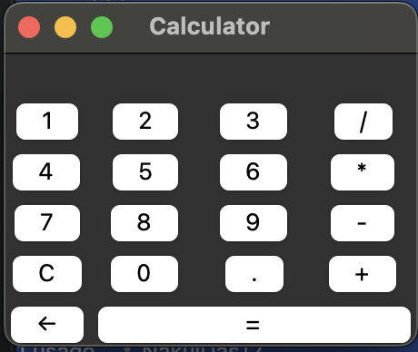
Code Overview
Importing Tkinter : import tkinter
Setting Up Main Window: root = tkinter.Tk()
root.title("Calculator")
Defining Functions: def add(value):
def clear():
def calculate():
def backspace():

Slide 8
Creating and Placing Widgets: label_result = tkinter.Label(root, text="")
label_result.grid(row=0, columnspan=4)
button_1 = tkinter.Button(root, text="1", command=lambda: add("1"))
button_1.grid(row=1, column=0)
Configuring Grid Layout: for i in range(6):
root.grid_rowconfigure(i, weight=1)
for i in range(4):
root.grid_columnconfigure(i, weight=1)

Slide 9
Conclusion
The Tkinter-based calculator application will provide a simple yet functional tool for basic arithmetic operations. By leveraging Python’s Tkinter library, the project aims to deliver a user-friendly GUI and a reliable calculation engine.

Slide 10


